Slide 1
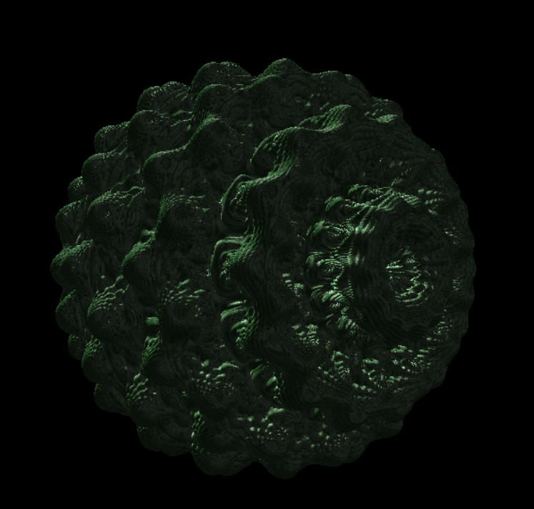
Animating the Mandelbulb using Ray Marching and optional keyframe animation
Final Project IG – Janne Rotter

Slide 2
Overview
Mathematical baseline – The Mandelbulb
Visualizing the Fractal
Surface Distance estimation
Ray Marching
Shading
Keyframe animation
Bibliography

Slide 3



Mathematical Baseline – the mundelbulb
The Mandelbulb is a three-dimensional analogue of the Mandelbrot set ^{[1]}
Follows a similar equation but with three coordinates:
In general, a point $z_{0}∈R^{3}$ is in the Mandelbulb iff.
“The point does not escape to infinity when iteratively applying the formula”
$$z_{n+1}={f(z}_{n})+z_{0}$$
$$¬(\lim_{n→∞}{z_{n}}=∞)$$

Slide 4
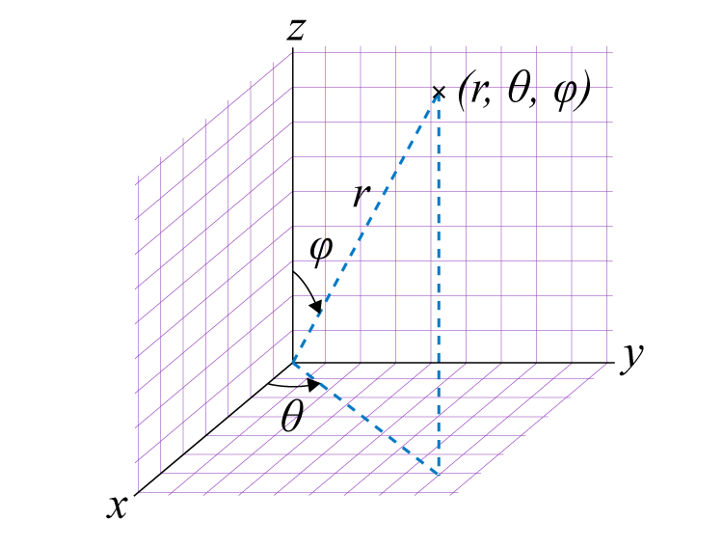

Mathematical Baseline – the mundelbulb
A useful rule of thumb: If a point leaves the bailoutradius (of 2) during the iteration it is NOT in the mandelbulb
The function f is defined on spherical coordinates as:
Fig 1: Spherical coordinates
$$f(r)=r^{p}$$
$$f(θ)= θ ∗p$$
$$f\left(φ\right)=φ∗p$$

Slide 5

Visualizing the fractal
Instead of checking if a point is in the mandelbulb we check how far a point is away from the mandelbulb
Better fitted to raymarching because we can take bigger steps towards the surface if the distance is large^{[2]}
With distance estimation
Take big steps if we are far away
Without distance estimation
Evaluate for a lot of points on the ray

Slide 6

Surface distance estimation
We define a function that returns the distance of a point to the surface of the mandelbulb
It does so by keeping track of the accumulating derivative regarding $z_{0}$

Slide 7
Ray marching

Slide 8
shading
Used directional light
Used diffuse and phong shading with option to add curvature based shading (CBS)

Slide 9
Keyframe animation

Slide 10
bibliography
[1] White, D. (2009). The unravelling of the real 3d mandelbrot fractal.
[2] Hvidtfeldt, C. (2011). Distance estimated 3D fractals V: The Mandelbulb – Different DE approximations. Hvidtfeldt.net. http://blog.hvidtfeldts.net/index.php/2011/09/distance-estimated-3d-fractals-v-the-mandelbulb-different-de-approximations/

Slide 11
bibliography
Fig 1: https://external-content.duckduckgo.com/iu/?u=https%3A%2F%2Fcdn1.byjus.com%2Fwp-content%2Fuploads%2F2019%2F09%2FSpherical-coordinate-system.png&f=1&nofb=1&ipt=57008388bee748abcb94df22c8643c78ac159a7639911e3b4828f72eb495da89&ipo=images, 24.03.2025

